Slide 1

Future Vehicle Education Workshop
- Advanced Exercises (Assignments)

Slide 2
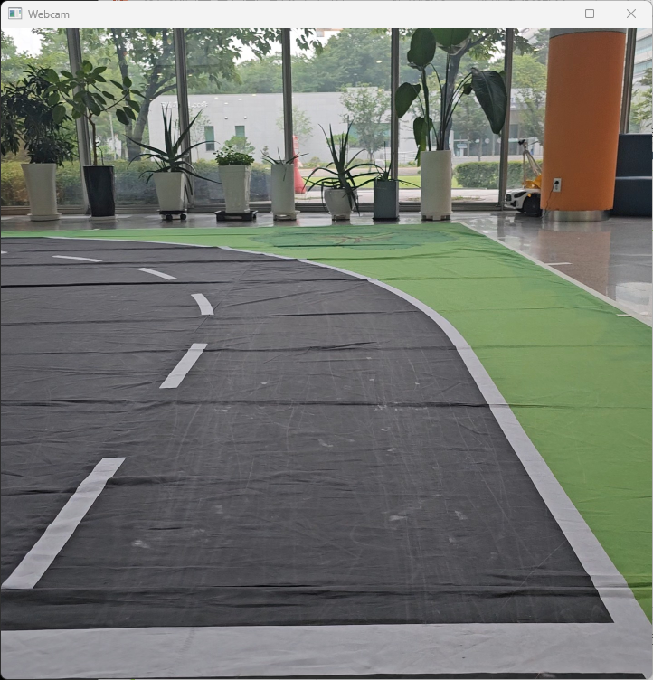
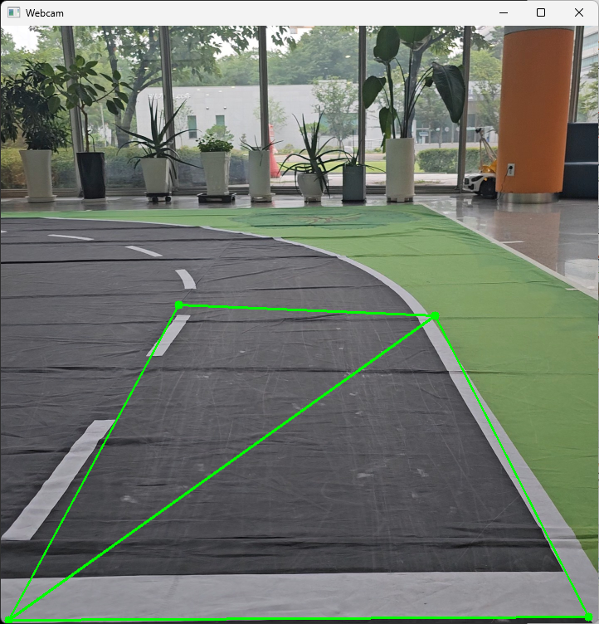
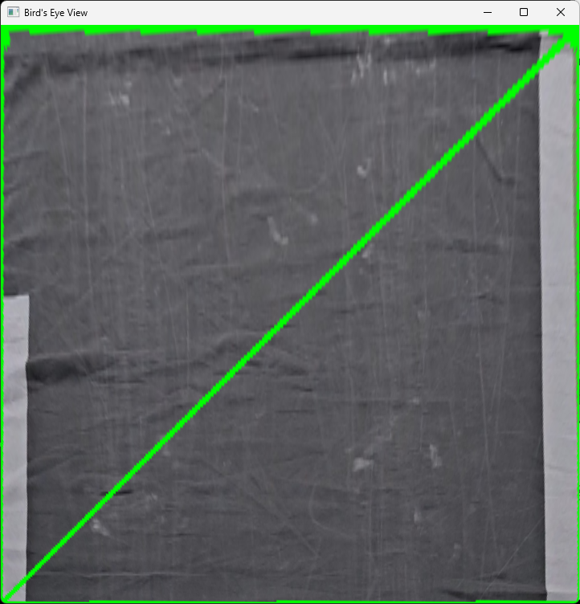
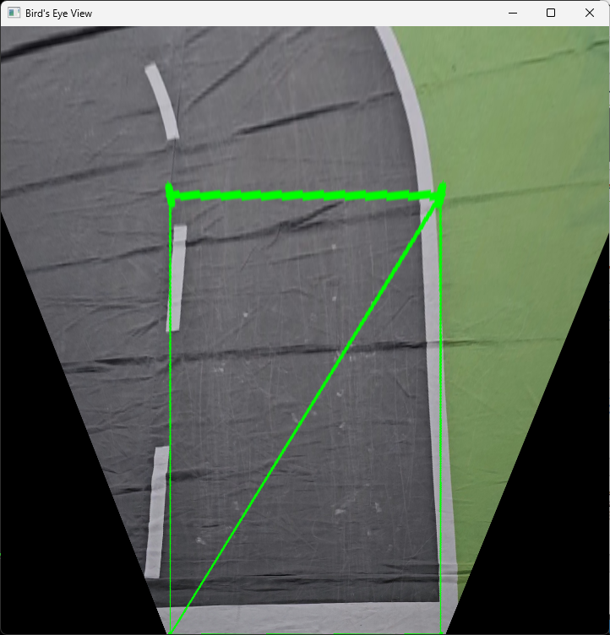
Advanced Ex 1
Bird’s-Eye-View application
Running with default settings, outputs like the 3rd picture→ Secure the view as shown in the 4th picture
Modify only the get_bird_eye_view() function in the start_lib.py file (1 line of settings).

Slide 3
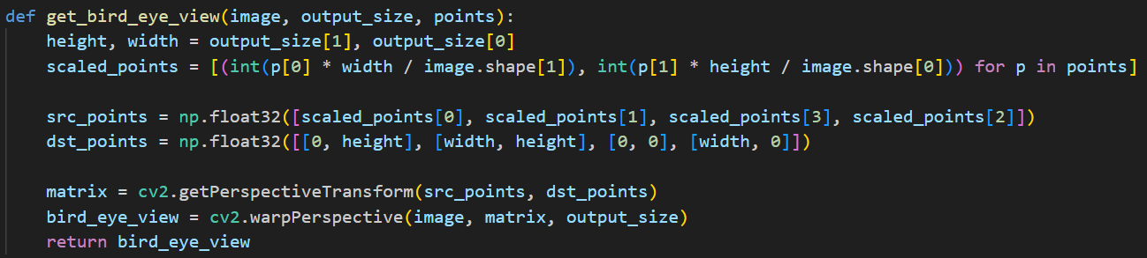
Advanced Ex 1
Bird’s-Eye-View application
Running with default settings, outputs like the 3rd picture→ Secure the view as shown in the 4th picture
Modify only the get_bird_eye_view() function in the start_lib.py file (1 line of settings).

Slide 4
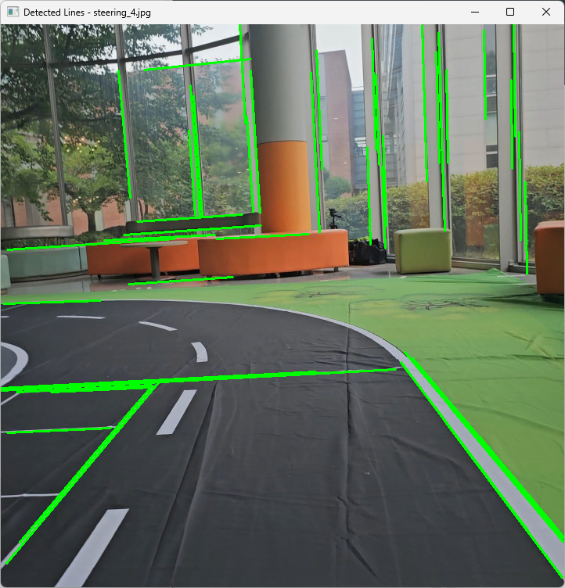
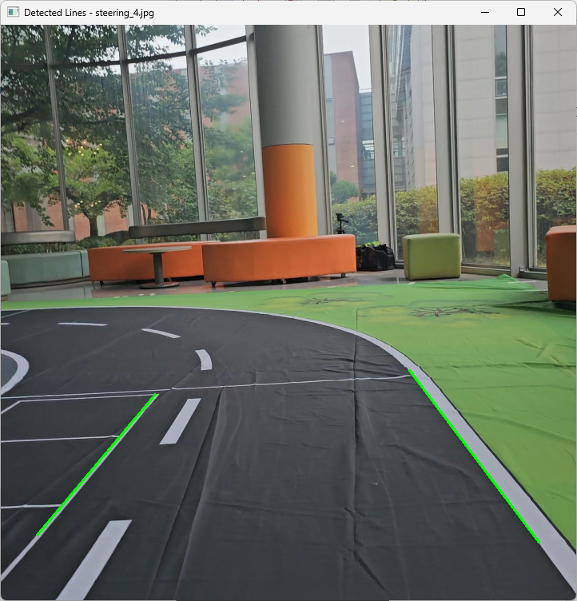
Advanced Ex 2
Hough Transform application
Running with default settings, output like the 1st photo→ Denoise like the 2nd photo
Add only the hough_transform() function to the straight_lib.py file (refer to the code provided in the basic example, 7 lines).

Slide 5
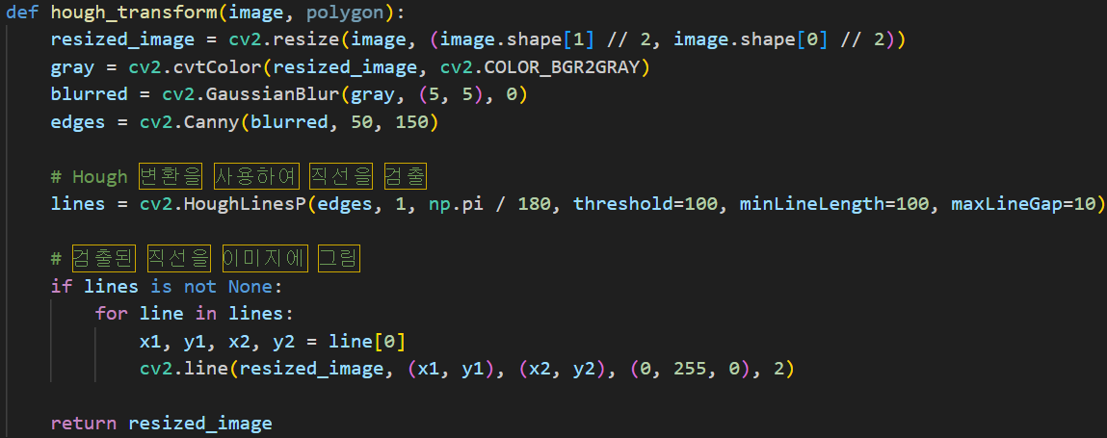
Advanced Ex 2
Hough Transform application
Running with default settings, output like the 1st photo→ Denoise like the 2nd photo
Add only the hough_transform() function to the straight_lib.py file (refer to the code provided in the basic example, 7 lines).

Slide 6
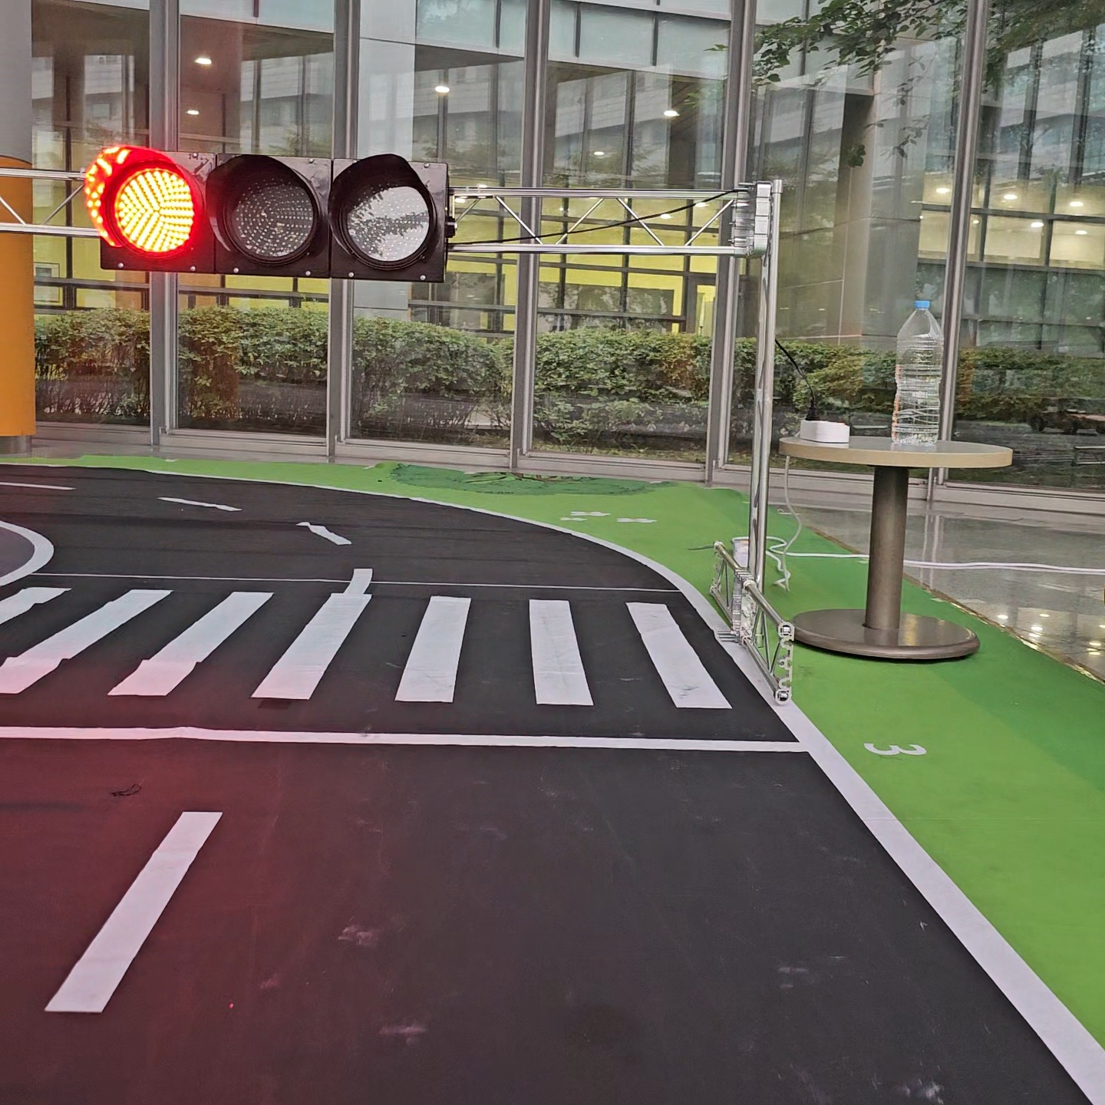
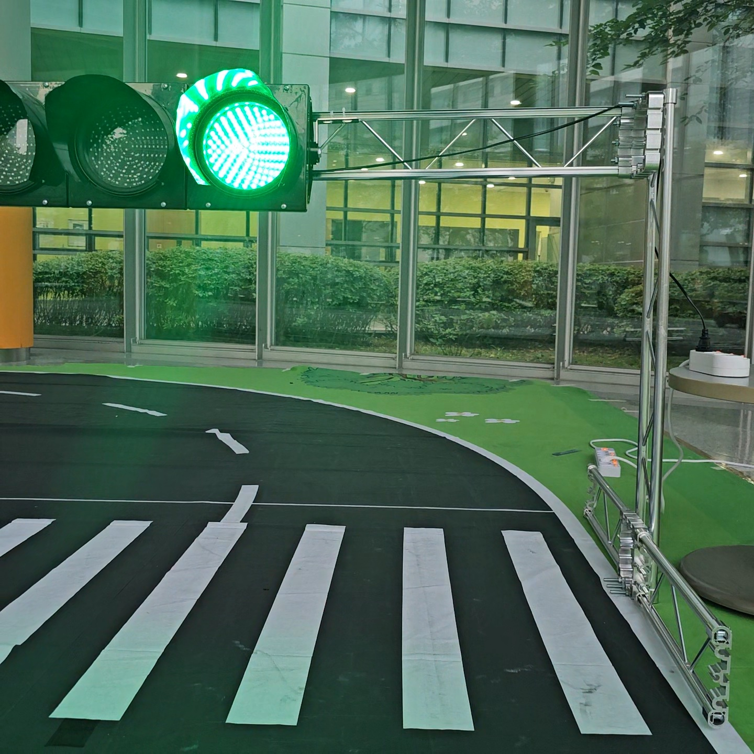
Advanced Ex 3
Applying HSV color space conversion
Traffic Light Color Recognition Examples → Modify the color range, check the operation, and apply

Slide 7
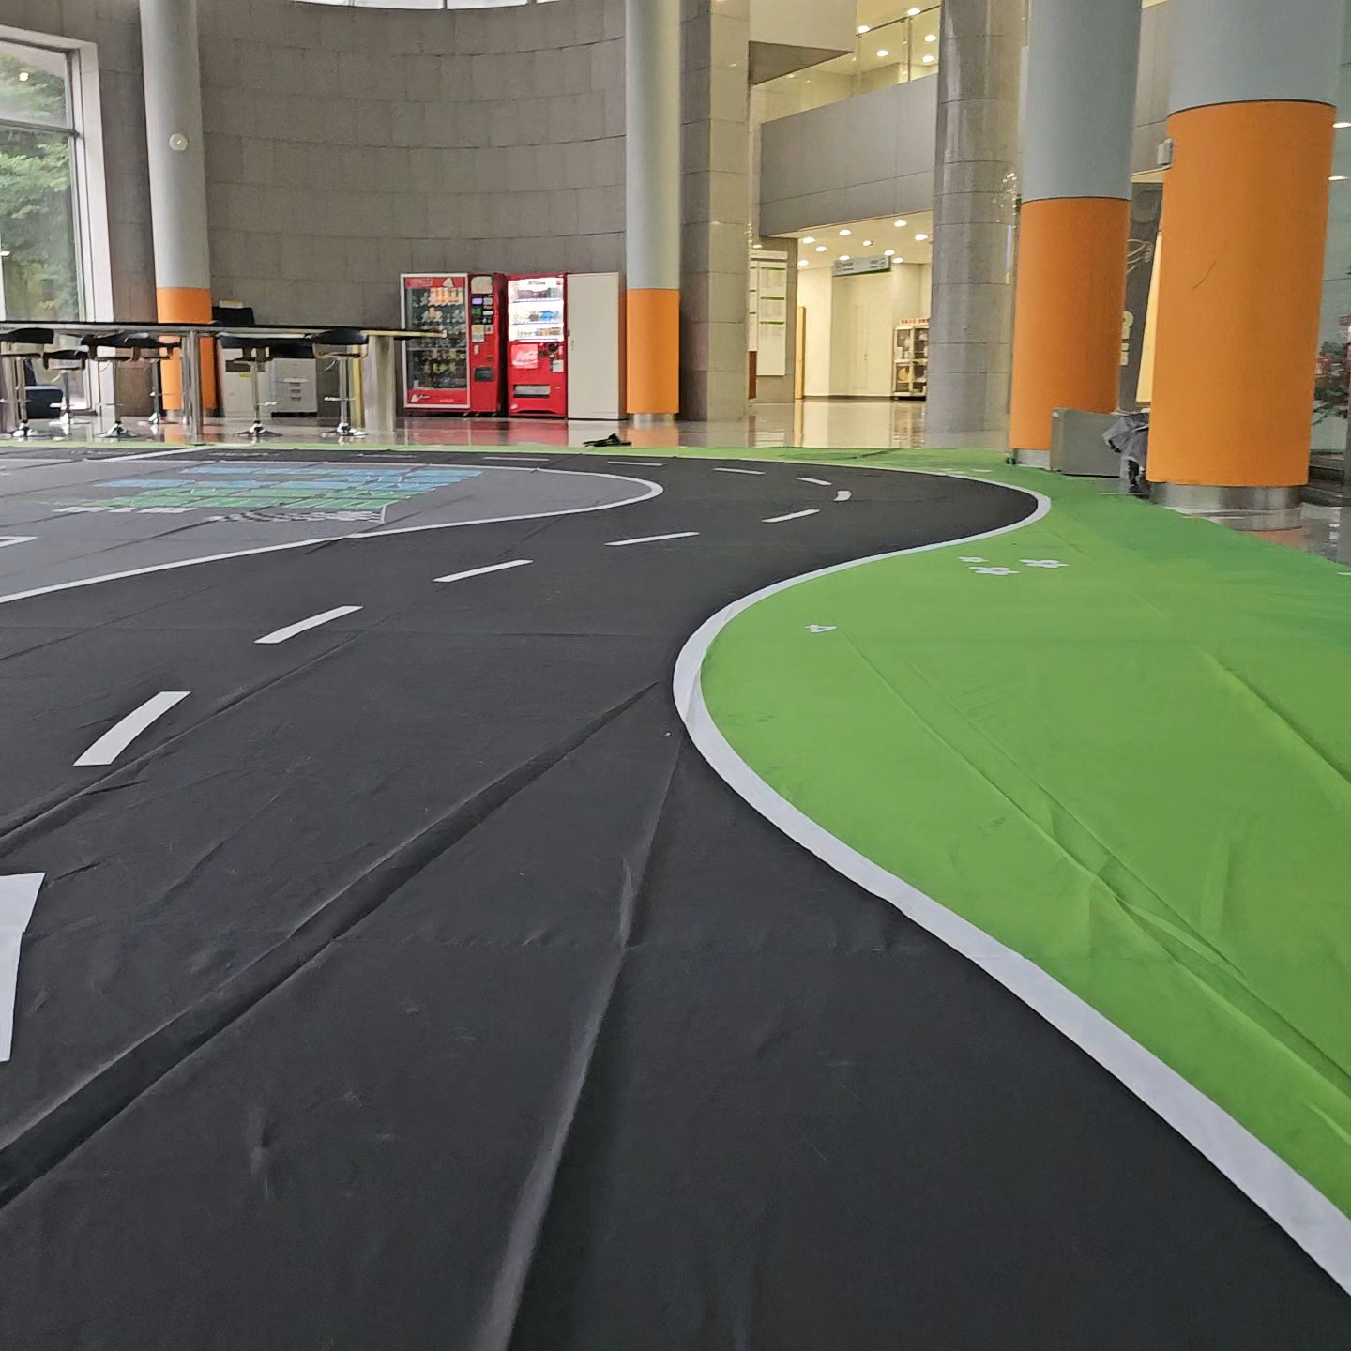
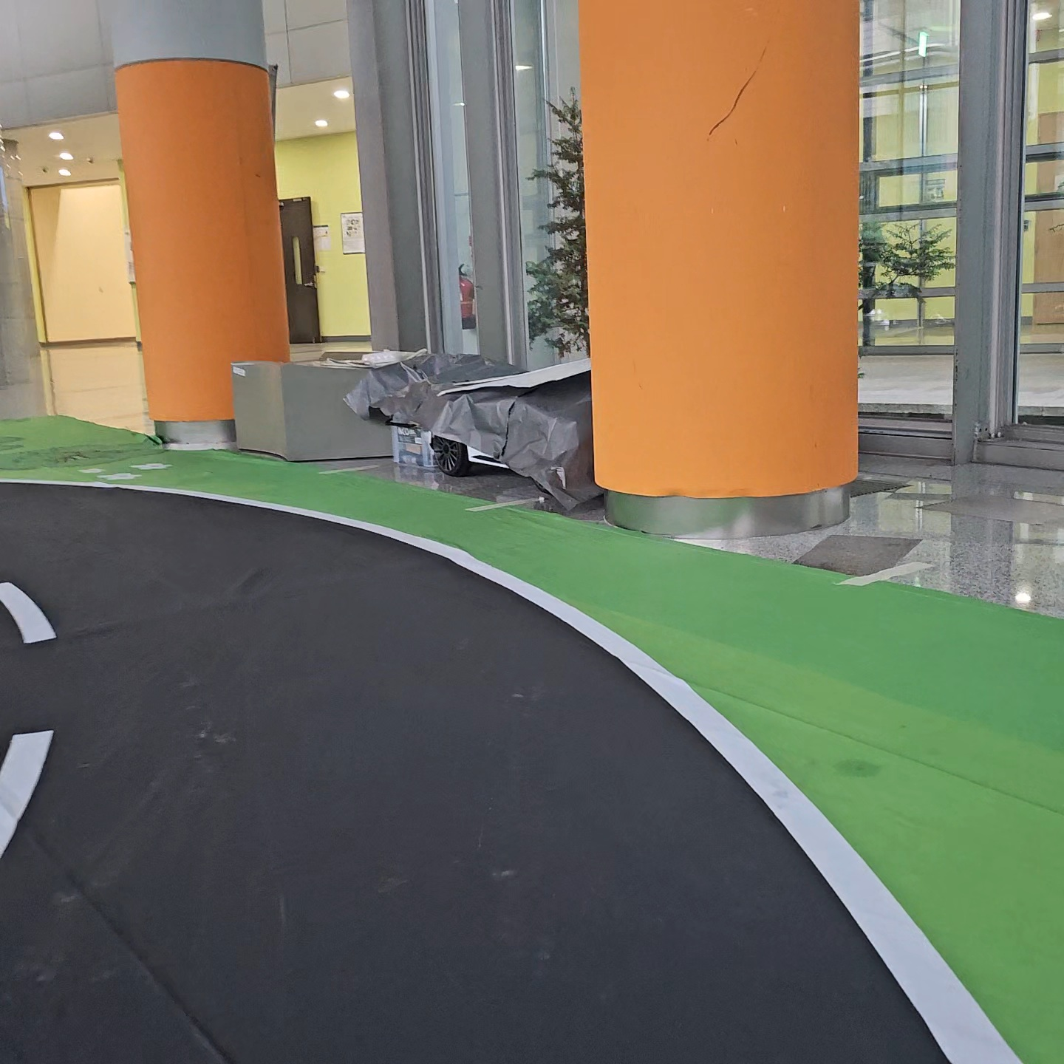
Advanced Ex 4
Reduced speed on S-shaped course
Lane analysis, motor control code provided → Steering and speed calculation, then motor control connection

Slide 8
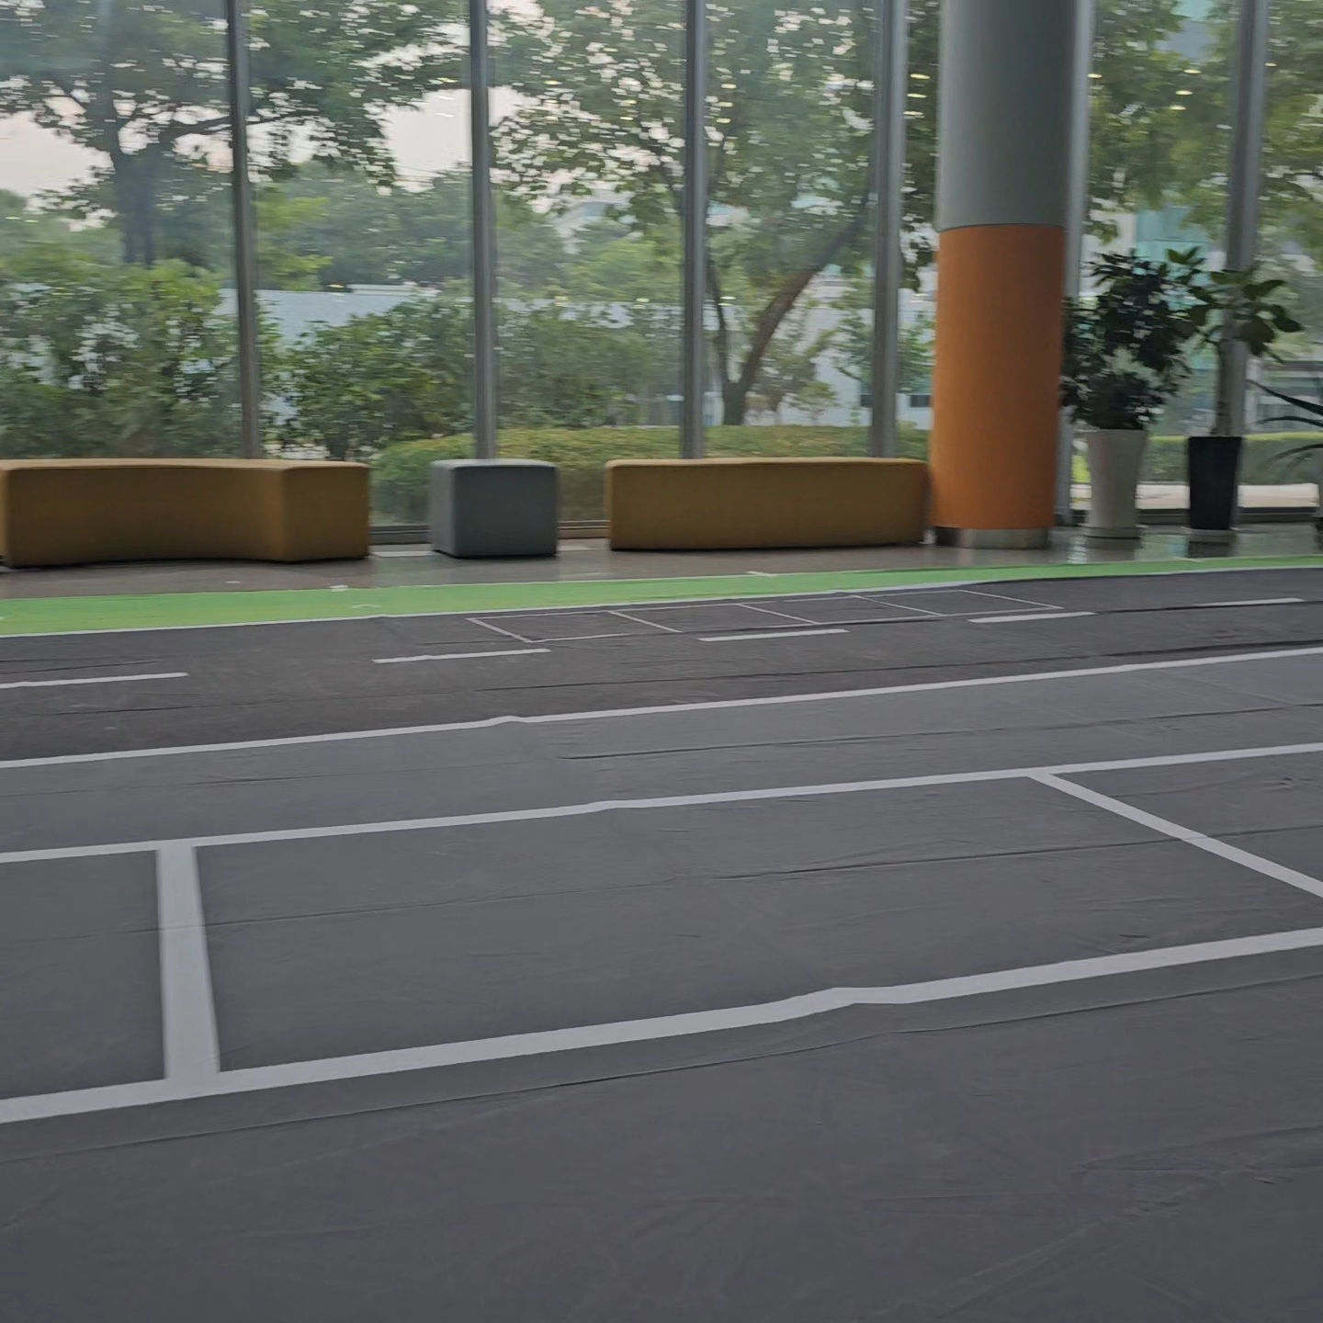
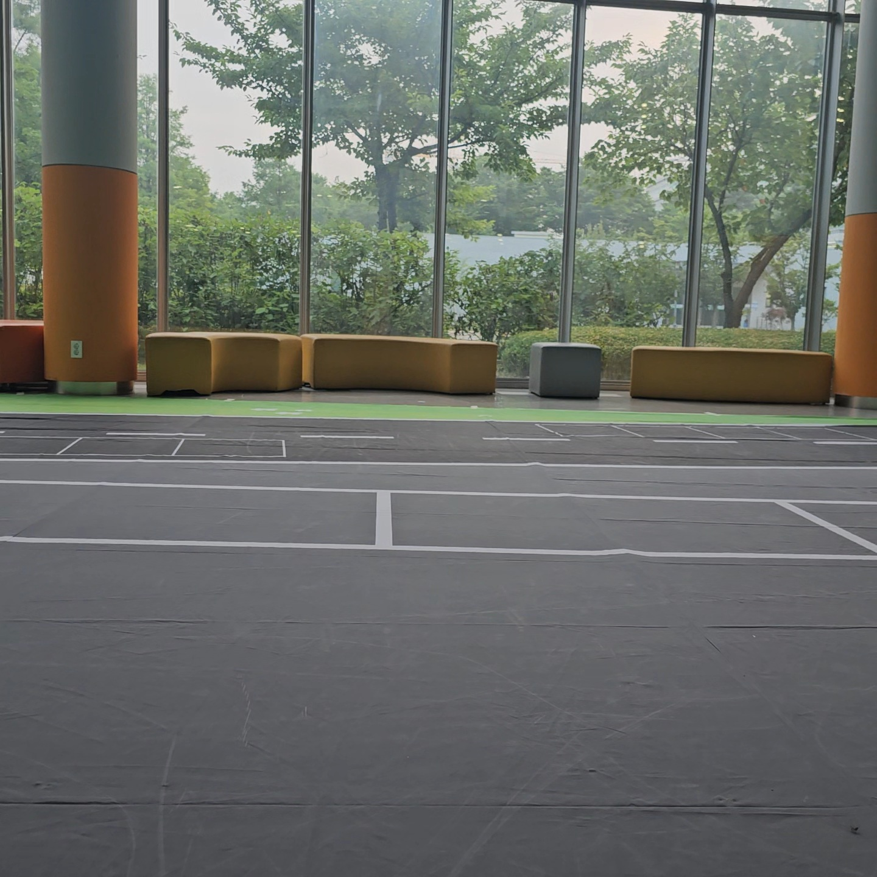
Advanced Ex 5
Understanding steering angle when reverse parking
Providing slope calculation and motor control code → Applied to reverse parking using parallel parking lines

